Slide 1
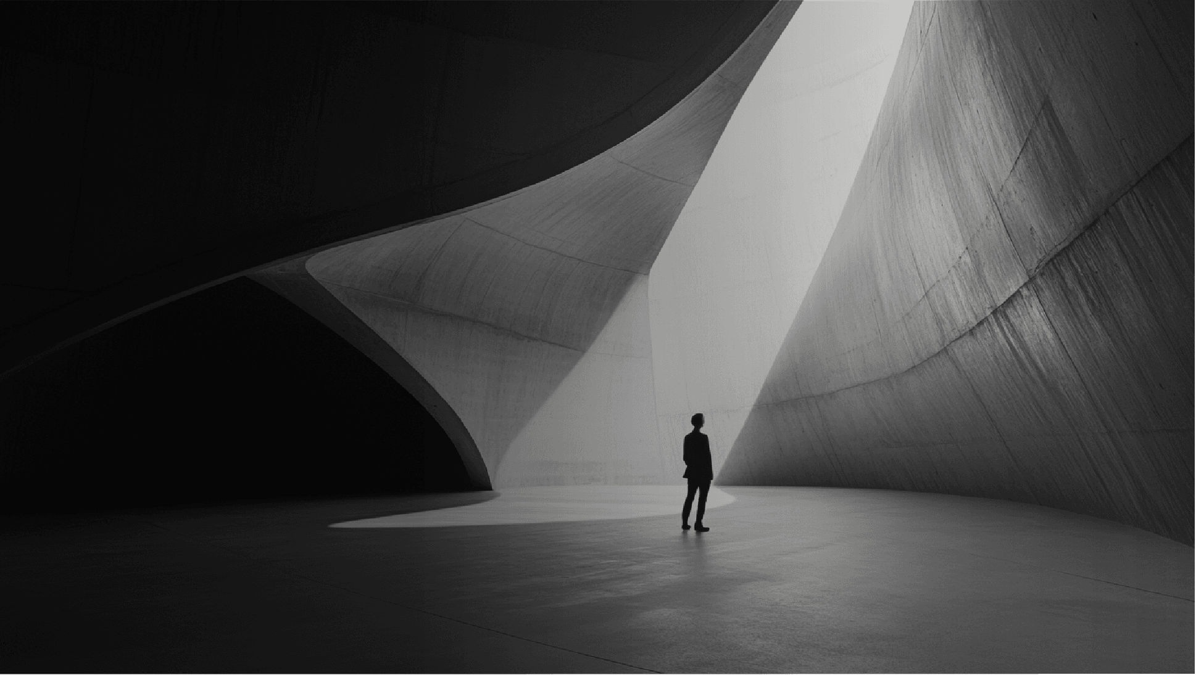
AI-Powered Attendance System

Slide 2







Project Overview
Operation & Interface
Features & Architecture
Results & Conclusion

Slide 3

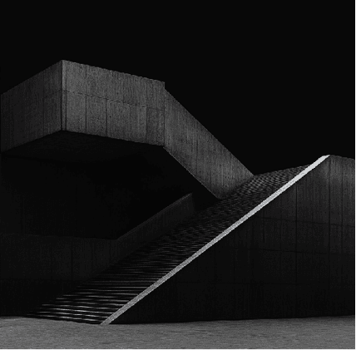

01
Project Overview

Slide 4
AI-Powered Attendance System
Team Members:
FA23-BCS-084 Nouman Ahmad
FA23-BCS-094 Syed Muhammad Sharjeel Farsheed
Machine Learning Fundamentals Project
Department of Computer Science
Instructor: Sir Umar Nouman

Slide 5
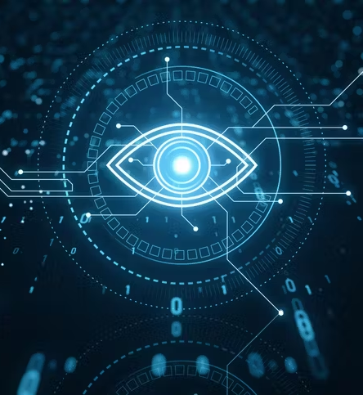
Introduction to the Project
This project presents a face recognition-based attendance system designed to automate the marking process by identifying students through their unique facial features.
Combines Computer Vision and Machine Learning within a web-based framework.
Built using Flask , Socket.IO , and OpenCV for real-time recognition.

Slide 6
System Overview and Workflow
Client (Browser)
Server (Flask)
Database (SQLite)
Captures live images using the camera.
Processes images, detects & recognizes faces.
Stores student details and attendance logs.
Operates over a local network (LAN) for accessibility via PC or mobile.

Slide 7
02
Features & Architecture

Slide 8
Key Features of the System
Real-time face detection & recognition
Student registration with image capture
Automatic attendance marking with timestamps
View & manage attendance records via web
Pretrained deep learning models integrated
Lightweight & mobile-friendly interface

Slide 9

System Architecture Breakdown
Frontend:
HTML, CSS, JavaScript (camera & UI).
Backend:
Flask web server, Socket.IO communication.
Recognition Engine:
Face detection (OpenCV DNN) + Embeddings (Facenet).
Database:
SQLite for students and attendance logs.

Slide 10
Implementation and Recognition Pipeline
→
→
Face Detection
Embedding Extraction
Recognition
OpenCV DNN with SSD model.
Facenet-like model producing 128-D vectors.
Compares embeddings using distance metrics.
Database: Two tables – students and attendance .

Slide 11
03
Operation & Interface

Slide 12
System Operation Flow
1. Register Student
2. Store Data
3. Mark Attendance
4. Log Entry
5. View Records
Capture images + metadata.
Save to dataset & DB.
Detect & recognize faces live.
Auto log with timestamp.
Dashboard updates instantly.

Slide 13
Database Structure
Models Used
Tables:
Pre-trained Models:
students
SSD-based Face Detector
(id, reg_no, name, semester, phone)
For robust face detection (OpenCV).
attendance
Facenet Embedding Model
(id, student_id, name, timestamp, confidence)
For generating unique 128-D face vectors.

Slide 14

User Interface Design
The frontend is built with a focus on simplicity and usability, ensuring a seamless experience across devices.
Built with HTML, CSS, and JavaScript.
Uses getUserMedia() for secure camera access.
Real-time communication via Socket.IO.
Register Student
Mark Attendance
View Records

Slide 15
04
Results & Conclusion

Slide 16
Testing Results and Deployment
Testing & Results
Deployment
Accuracy: 85–90% (under good lighting)
Local: Simple deployment with `python server.py`
Recognition Time: pan>
Production: Use HTTPS, reverse proxy (Nginx/Gunicorn)
LAN Access: Successful on desktop & mobile
Data Integrity: Verified timestamp & record creation
Troubleshooting: Camera perms, LAN IP, firewall configs

Slide 17



